Slide 1
Wine Recommender
Daniel Palumbo, Dante Bellins, Grace Ye

Slide 2
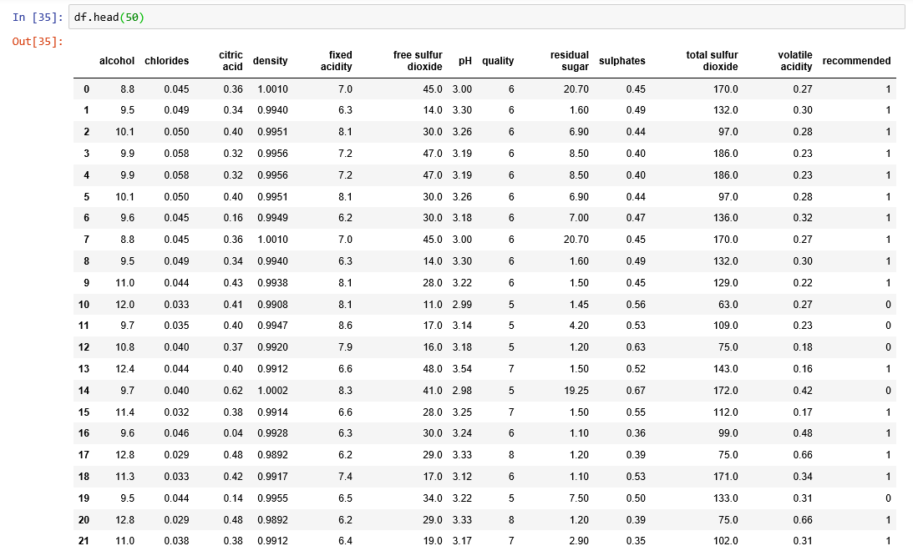

Slide 3
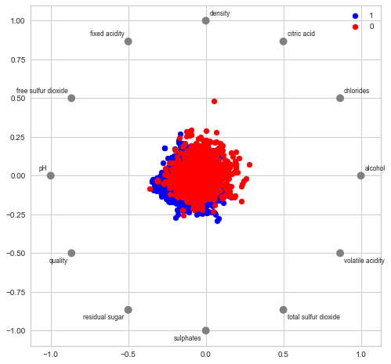
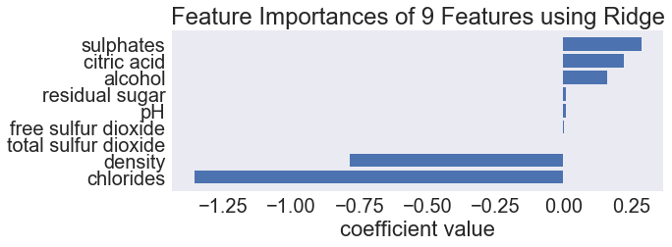

Slide 4
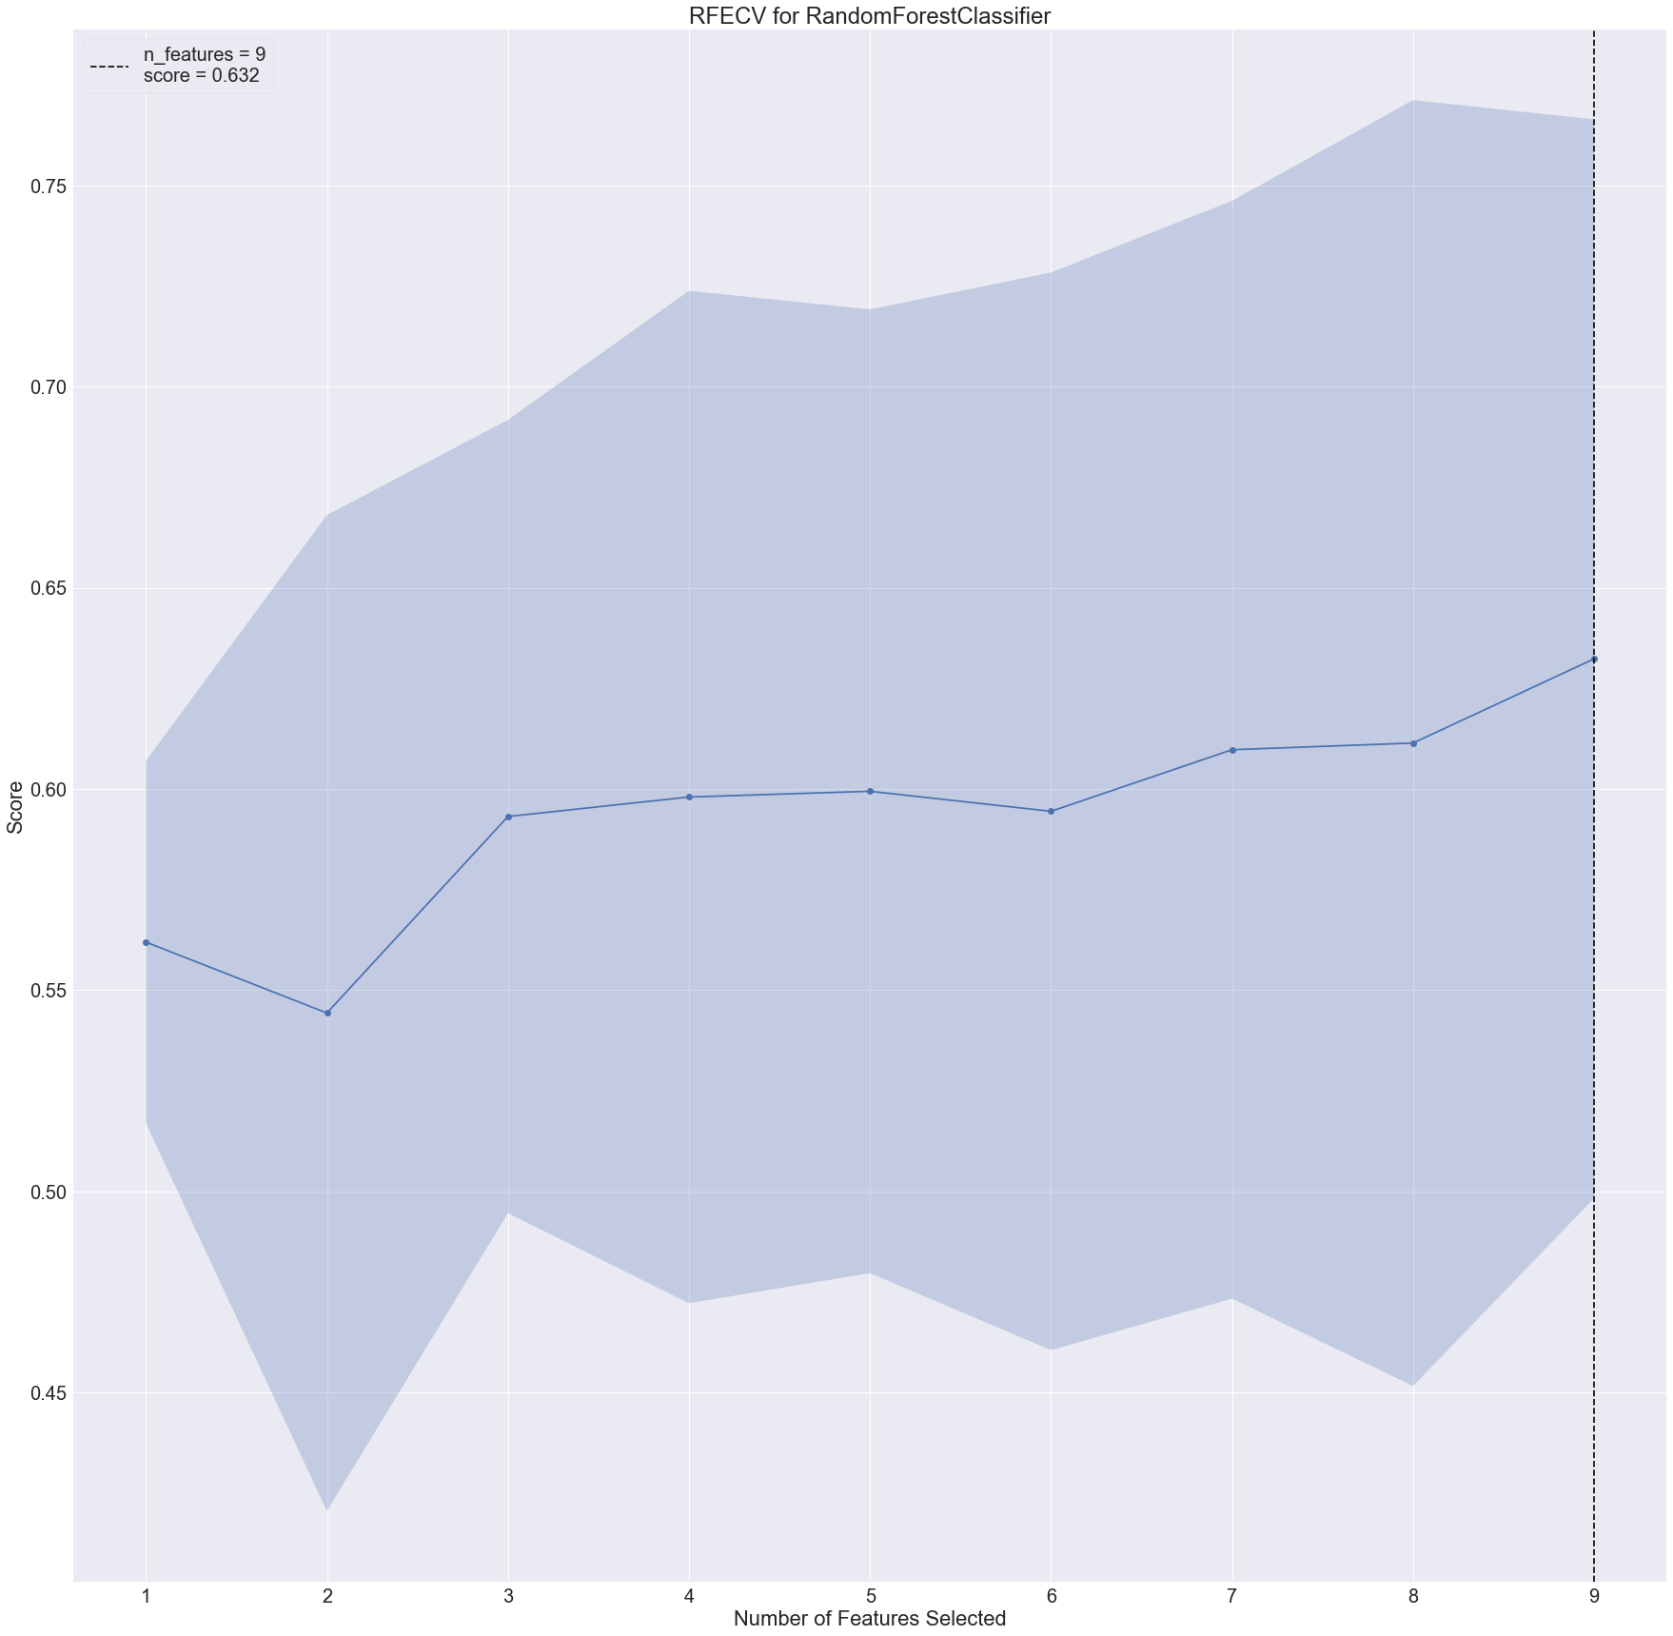

Slide 5
